Slide 1


CAPSTONE PROJECT PRESENTATION
Project Code: MEx
Hanoi, September 1st 2017

Slide 2


Team Members
Supervisor
Mr. HOANG XUAN SON
Do Cao Phong
Pham Minh Hoang
Luyen Bao Anh
Le Xuan Huong
Phung Duc Luat
Dang Ngoc Tu
Software Developer
Hardware Developer
Team leader
Technical Leader
QA Leader
Test Leader

Slide 3
Presentation Agenda
1
Introductions
Project Implementation
2
3
Research and Implementation
Product Demo
4
5
Question and Answer

Slide 4
1. INTRODUCTION
How do we get the problem ?
How did the idea come to us ?

Slide 5
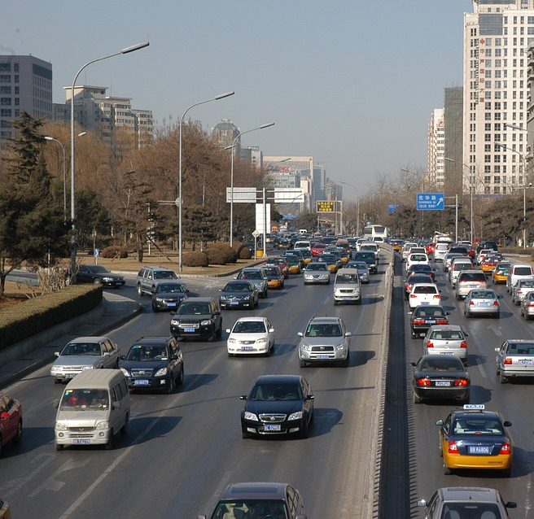
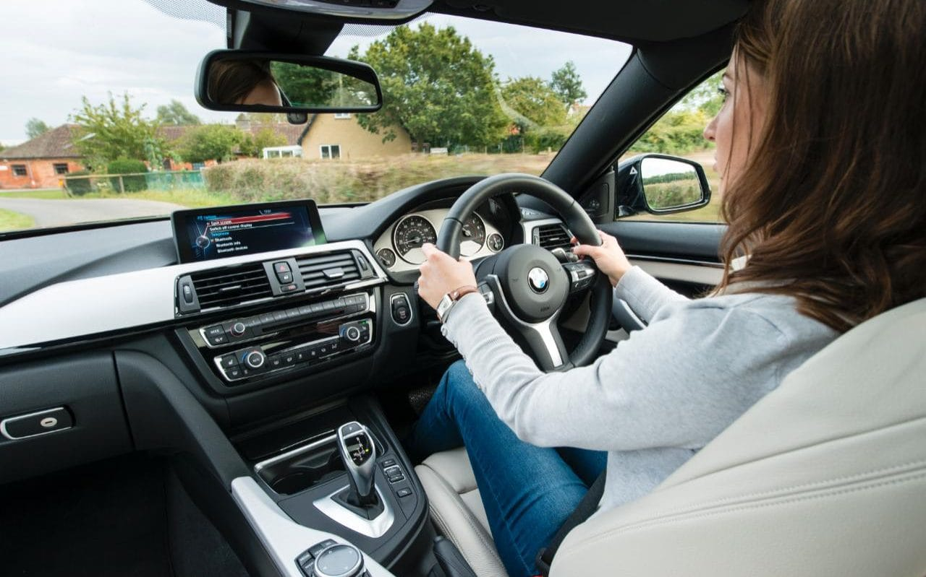
THE PROBLEM

Slide 6
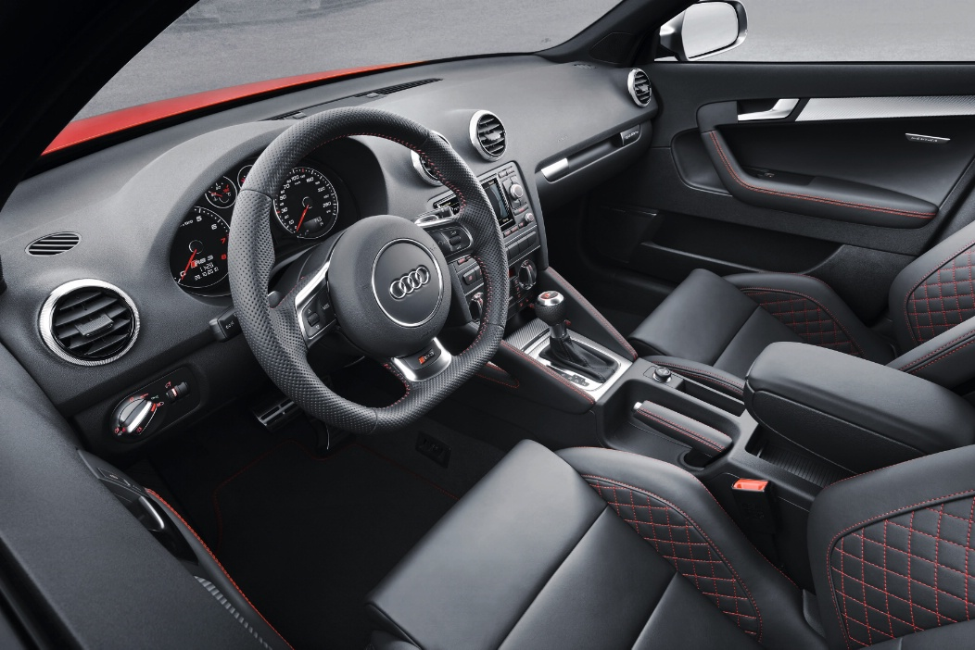
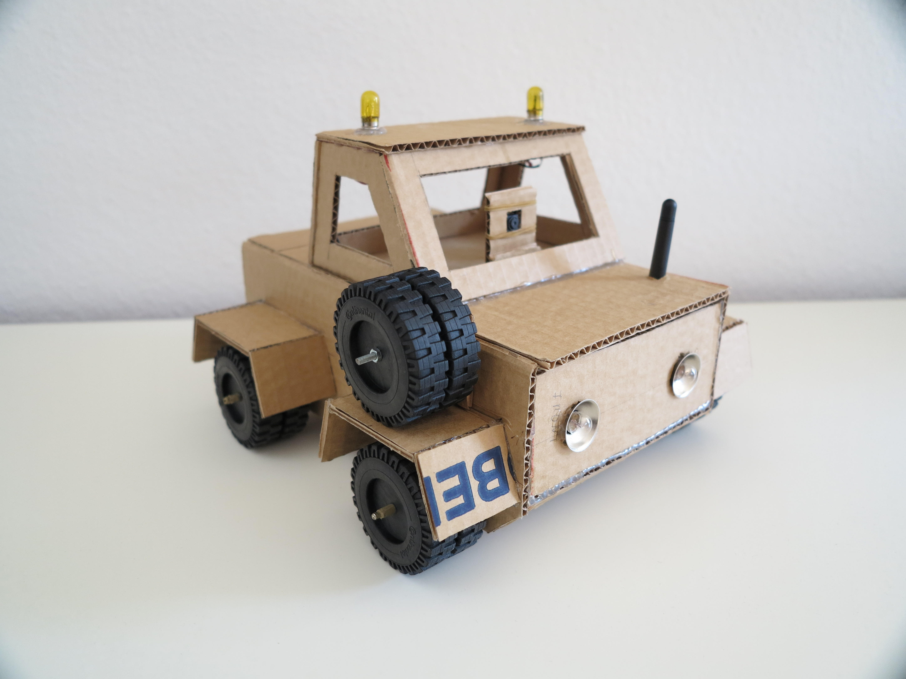
IDEA

Slide 7
Solution Overview

Slide 8
2. PROJECT IMPLEMENTATION
System development plan
Risk
Management
plan
Development
tools
Requirement

Slide 9
System Development Plan
Requirement
Implementation
Planning
Deployment
Evaluation
Testing
Iterative and Incremental Software Process Model

Slide 10












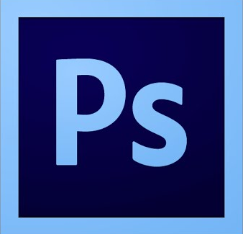



Development Tools
4
3
2
Operating Systems
Programming Languages
Electronic Design Tools
Others:

Slide 11
Risk management plan

Slide 12
Requirement specification
Overview

Slide 13
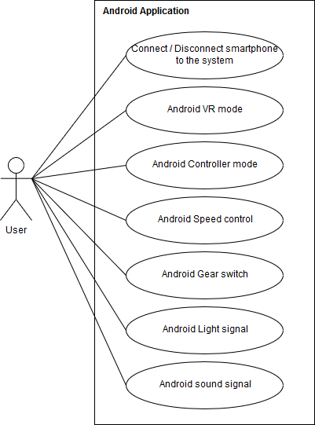
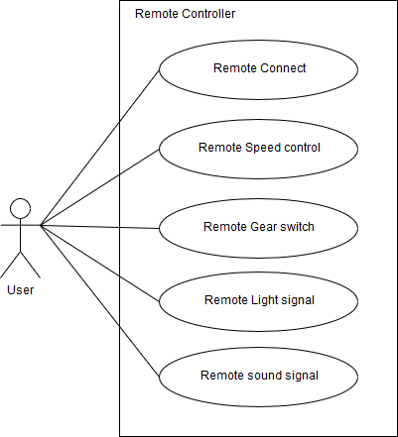
Requirement Specification

Slide 14
Requirement Specification
Non functional-requirement

Slide 15
Mechanism Design

Slide 16
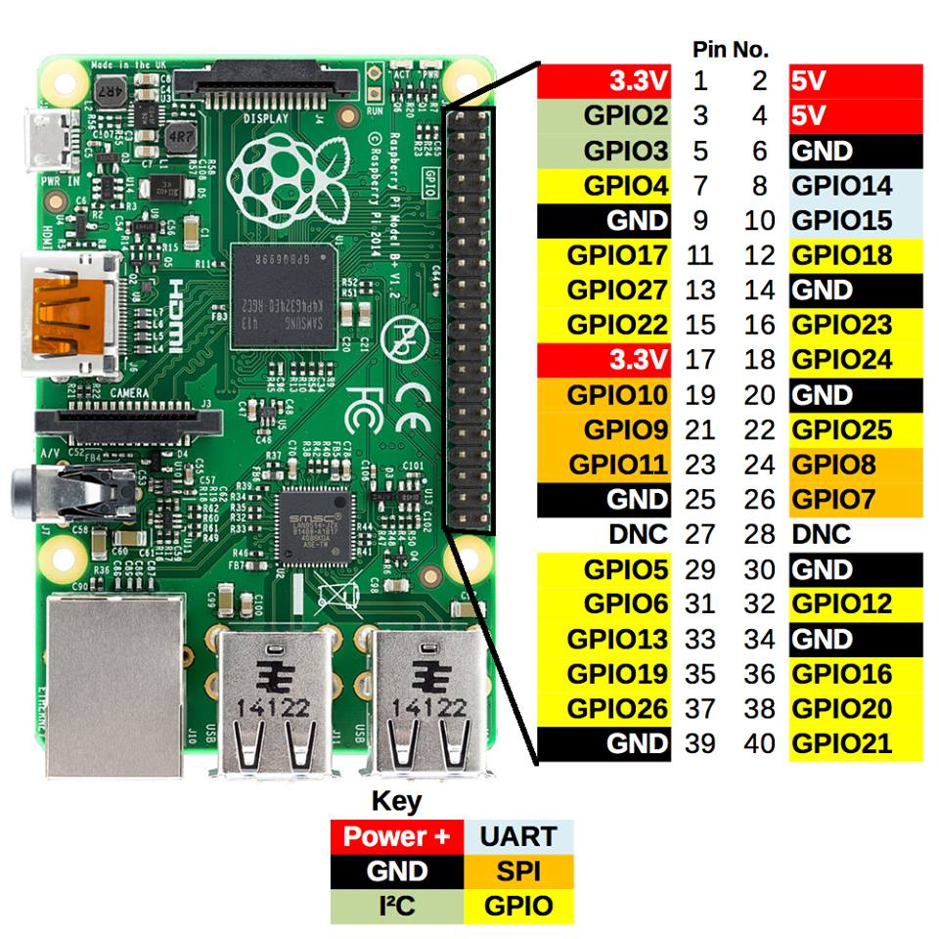
Module and communication
Raspberry Pi 3 Model B
Processor | Broadcom BCM2837 SoC with a 1.2 GHz 64-bit quad-core ARM Cortex-A53 processor, with 512 KB shared L2 cache
GPU | Broadcom VideoCore IV @ 250 MHz OpenGL ES 2.0 MPEG-2 and VC-1
Memory | 1GB
Operating System | Boots from Micro SD card, running a version of the Linux operating system or Windows 10 IoT
Network | 10/100 Mbit/s Ethernet, 802.11n wireless built-in, Bluetooth 4.1
GPIO Connector | 40-pin 2.54 mm (100 mil) expansion header: 2x20 strip Providing 27 GPIO pins as well as +3.3 V, +5 V and GND supply lines

Slide 17
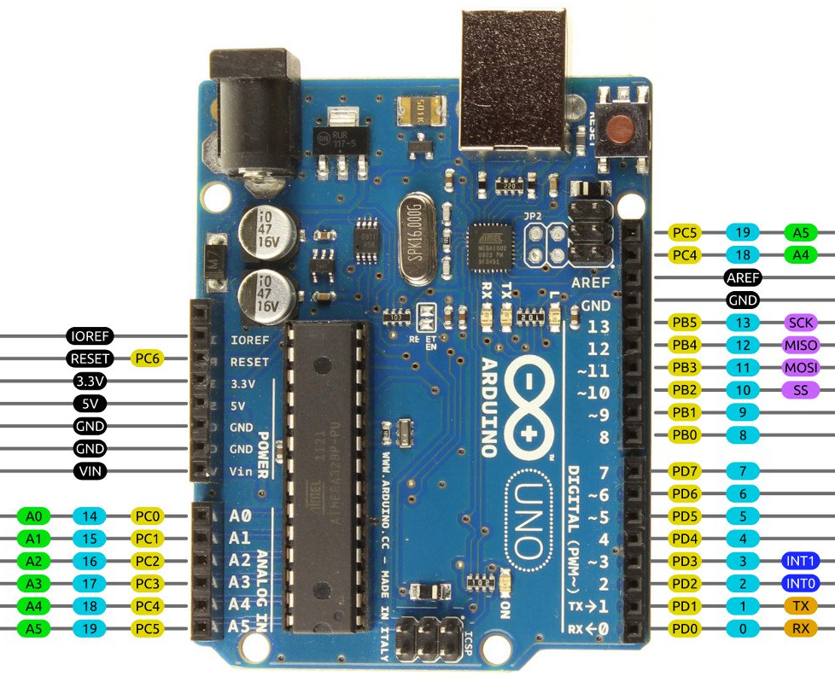
Module and communication
Arduino Uno R3
Microcontroller | ATmega328
Architecture | AVR
Operating Voltage | 5V
Flash memory | 32KB of which 0.5 KB used by bootloader
SRAM | 2KB
Clock Speed | 16 MHZ
EEPROM | 1 KB
DC Current per I/O pins | 40 mA on I/O pins; 50 mA on 3.3V pin
Input Voltage | 7 – 12 V
Digital I/O pins | 20
Analog I/O Pins | 6
Board Dimensions | 68.6mm x 53.4mm

Slide 18
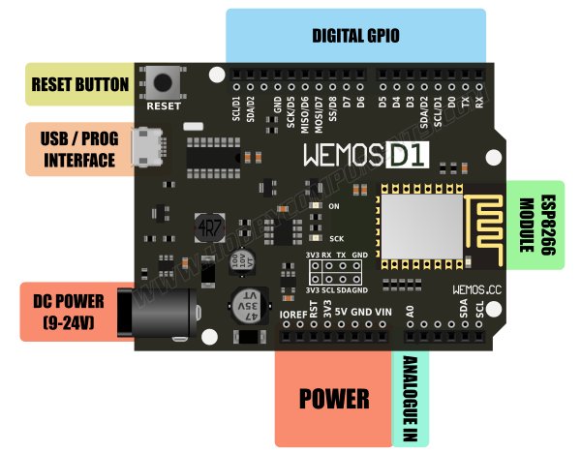
Module and communication
WeMos D1
Microcontroller | ESP8266EX
Operating Voltage | 3.3V
Input Voltage Range | 9V to 12V
Output | 5V at 1A max
Digital I/O pins | 11
Analog input pins | 1
Flash Memory | 4MB
Board Dimensions | 68.6mm x 53.4mm
Weight | 21.8g

Slide 19
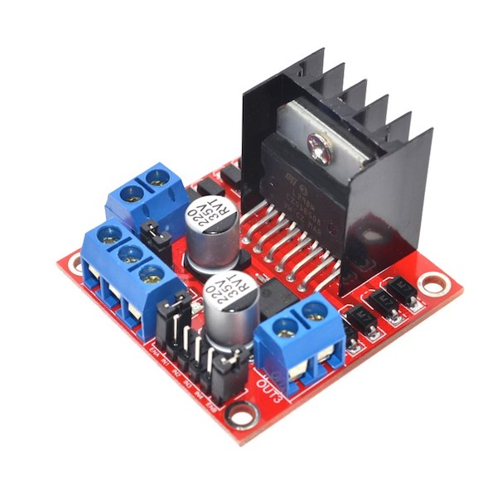
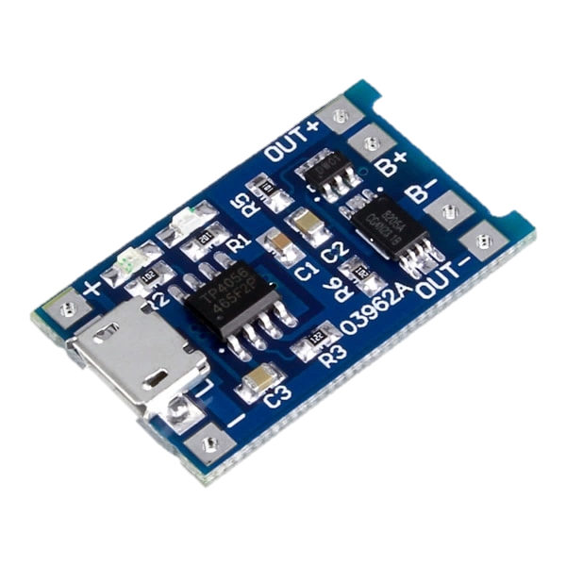
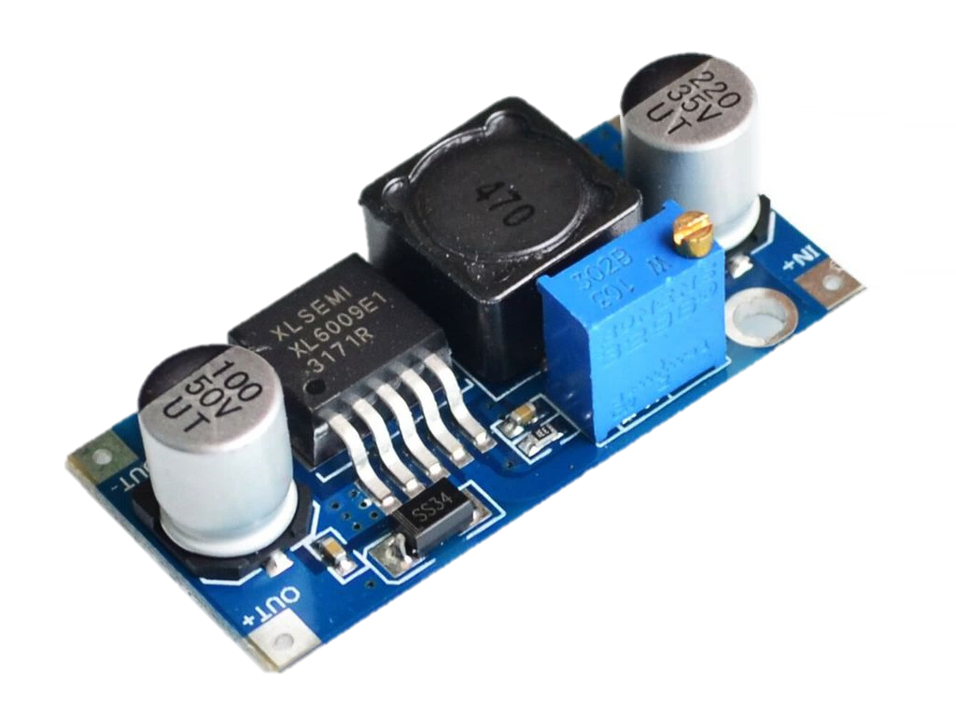
Module and communication
Other modules
L298N
Motor Controller
TP4056
Charging circuit
XL6009
Switching Current Boost
Power supply | +5 V ~ +35 V
Peak output current | 2A/channel
Logic power output | +5 V ~ +7 V
Logic current | 0 ~ 36ma
Max power | 20W(Temperature 75 ℃)
Working temperature | -25 ℃ ~ +130 ℃
Input voltage | 4.5 ~ 5.5V
Full charge voltage | 4.2V
Operating ambient temperature range | -10­­ºC ~ +85ºC
Charging Current | 1A
Input voltage | 3.2V ~ 32V
Output Voltage | 4V ~ 38V
Rectification | Non-synchronous rectification
Rated output current | 3A
Peak Output Current | 4A
Conversion efficiency | Up to 94%

Slide 20
Instructions for use
EDIT IN GOOGLE SLIDES
Click on the button under the presentation preview that says "Use as Google Slides Theme".
You will get a copy of this document on your Google Drive and will be able to edit, add or delete slides.
You have to be signed in to your Google account.
EDIT IN POWERPOINT®
Click on the button under the presentation preview that says "Download as PowerPoint template". You will get a .pptx file that you can edit in PowerPoint.
Remember to download and install the fonts used in this presentation (you’ll find the links to the font files needed in the Presentation design slide)
More info on how to use this template at www.slidescarnival.com/help-use-presentation-template
This template is free to use under Creative Commons Attribution license. You can keep the Credits slide or mention SlidesCarnival and other resources used in a slide footer.

Slide 21

Hello!
I am Jayden Smith
I am here because I love to give presentations.
You can find me at @username

Slide 22
1.
Transition headline
Let’s start with the first set of slides

Slide 23
Quotations are commonly printed as a means of inspiration and to invoke philosophical thoughts from the reader.

Slide 24
This is a slide title
Here you have a list of items
And some text
But remember not to overload your slides with content
Your audience will listen to you or read the content, but won’t do both.

Slide 25
Big concept
Bring the attention of your audience over a key concept using icons or illustrations

Slide 26
You can also split your content
White
Is the color of milk and fresh snow, the color produced by the combination of all the colors of the visible spectrum.
Black
Is the color of coal, ebony, and of outer space. It is the darkest color, the result of the absence of or complete absorption of light.

Slide 27
In two or three columns
Yellow
Is the color of gold, butter and ripe lemons. In the spectrum of visible light, yellow is found between green and orange.
Blue
Is the colour of the clear sky and the deep sea. It is located between violet and green on the optical spectrum.
Red
Is the color of blood, and because of this it has historically been associated with sacrifice, danger and courage.

Slide 28
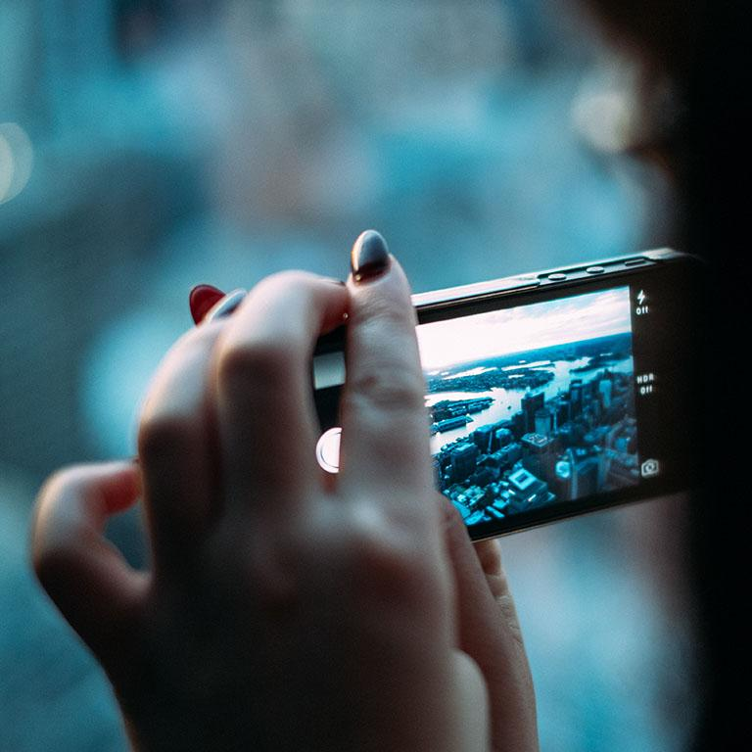
A picture is worth a thousand words
A complex idea can be conveyed with just a single still image, namely making it possible to absorb large amounts of data quickly.

Slide 29

Want big impact?
Use big image.

Slide 30
Use charts to explain your ideas
Yellow
Blue
Red

Slide 31
And tables to compare data
 | A | B | C
Yellow | 10 | 20 | 7
Blue | 30 | 15 | 10
Orange | 5 | 24 | 16

Slide 32
Maps
our office

Slide 33
89,526,124
Whoa! That’s a big number, aren’t you proud?

Slide 34
89,526,124$
185,244 users
100%
That’s a lot of money
And a lot of users
Total success!

Slide 35
Our process is easy
first
second
last

Slide 36
Let’s review some concepts
Yellow
Is the color of gold, butter and ripe lemons. In the spectrum of visible light, yellow is found between green and orange.
Blue
Is the colour of the clear sky and the deep sea. It is located between violet and green on the optical spectrum.
Red
Is the color of blood, and because of this it has historically been associated with sacrifice, danger and courage.
Yellow
Is the color of gold, butter and ripe lemons. In the spectrum of visible light, yellow is found between green and orange.
Blue
Is the colour of the clear sky and the deep sea. It is located between violet and green on the optical spectrum.
Red
Is the color of blood, and because of this it has historically been associated with sacrifice, danger and courage.

Slide 37
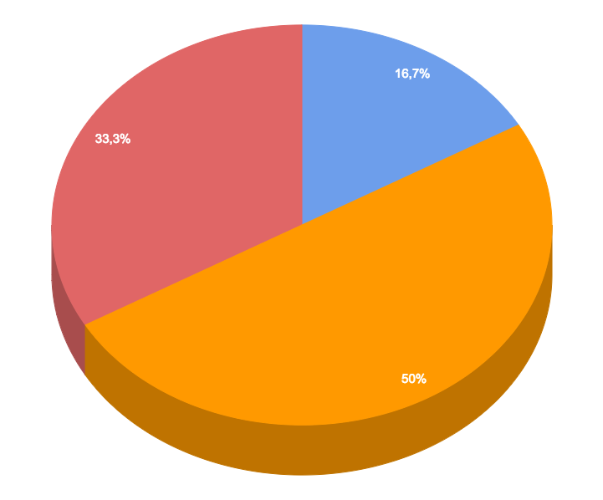
You can insert graphs from Google Sheets

Slide 38
Android project
Show and explain your web, app or software projects using these gadget templates.
Place your screenshot here

Slide 39
iPhone project
Show and explain your web, app or software projects using these gadget templates.
Place your screenshot here

Slide 40
Tablet project
Show and explain your web, app or software projects using these gadget templates.
Place your screenshot here

Slide 41
Desktop project
Show and explain your web, app or software projects using these gadget templates.
Place your screenshot here

Slide 42
Thanks!
Any questions?
You can find me at @username & user@mail.me

Slide 43
Credits
Special thanks to all the people who made and released these awesome resources for free:
Presentation template by SlidesCarnival
Photographs by Unsplash

Slide 44
Presentation design
This presentation uses the following typographies and colors:
Titles: Roboto Slab Light
Body copy: Lato Light
You can download the fonts on these pages:
http://www.latofonts.com/lato-free-fonts/
https://www.fontsquirrel.com/fonts/roboto-slab
Aqua #02bdc7 · Yellow #ffb600 · Magenta #fc4067
You don’t need to keep this slide in your presentation. It’s only here to serve you as a design guide if you need to create new slides or download the fonts to edit the presentation in PowerPoint®

Slide 45
SlidesCarnival icons are editable shapes.
This means that you can:
Resize them without losing quality.
Change line color, width and style.
Isn’t that nice? :)
Examples:

Slide 46
😉
Now you can use any emoji as an icon!
And of course it resizes without losing quality and you can change the color.
How? Follow Google instructions https://twitter.com/googledocs/status/730087240156643328
✋👆👉👍👤👦👧👨👩👪💃🏃💑❤😂😉😋😒😭👶😸🐟🍒🍔💣📌📖🔨🎃🎈🎨🏈🏰🌏🔌🔑 and many more...

